Slide 1
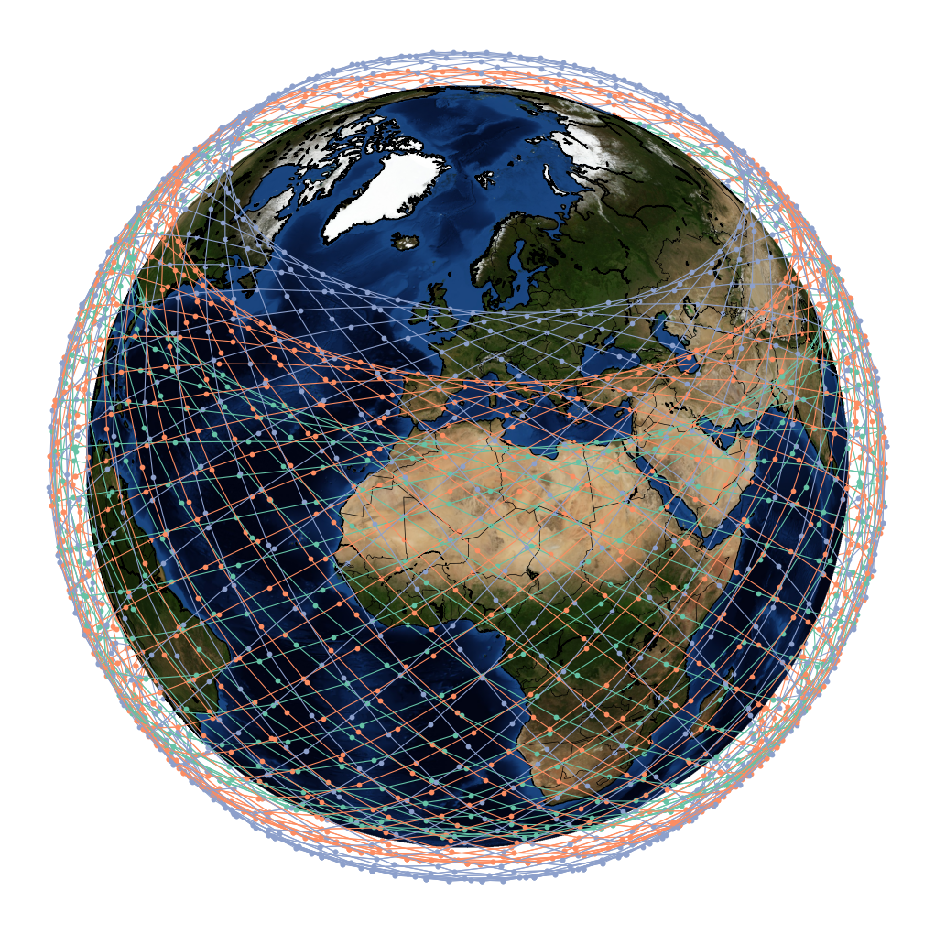
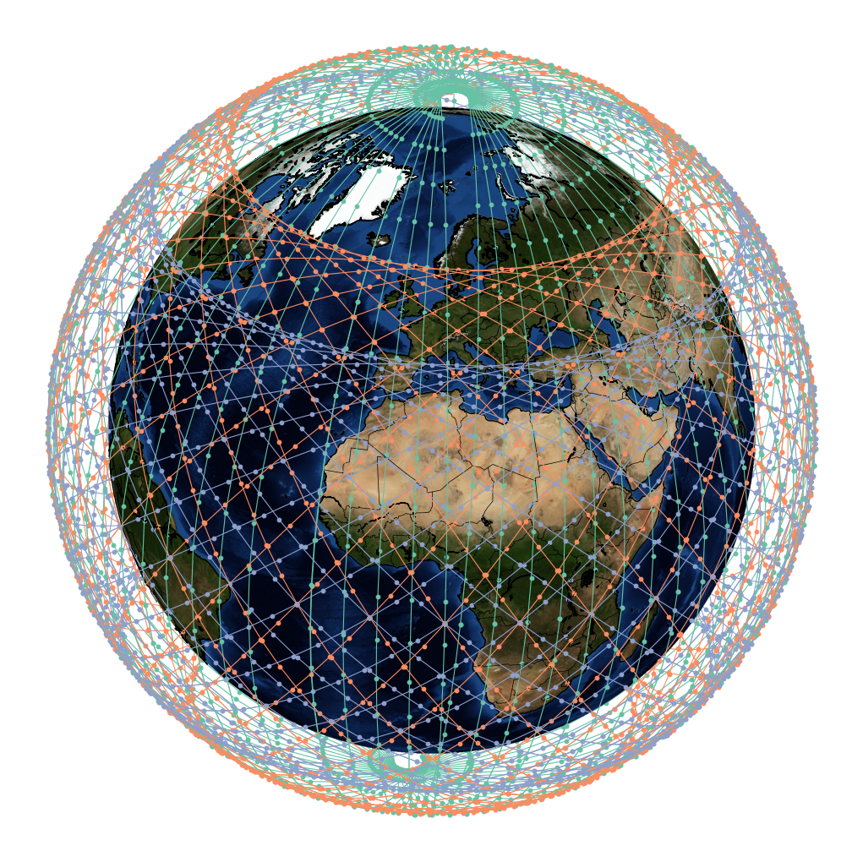
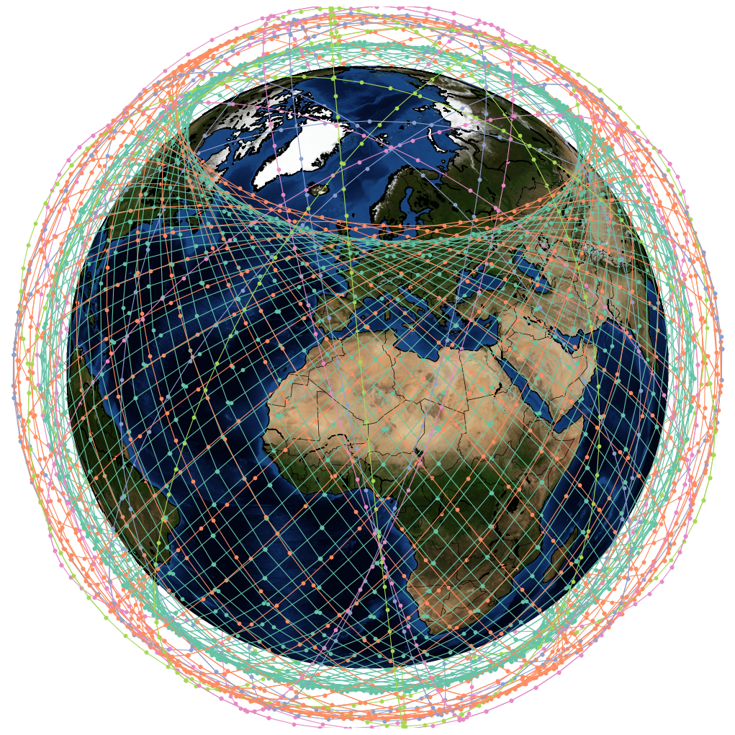
a
b
c

Slide 2
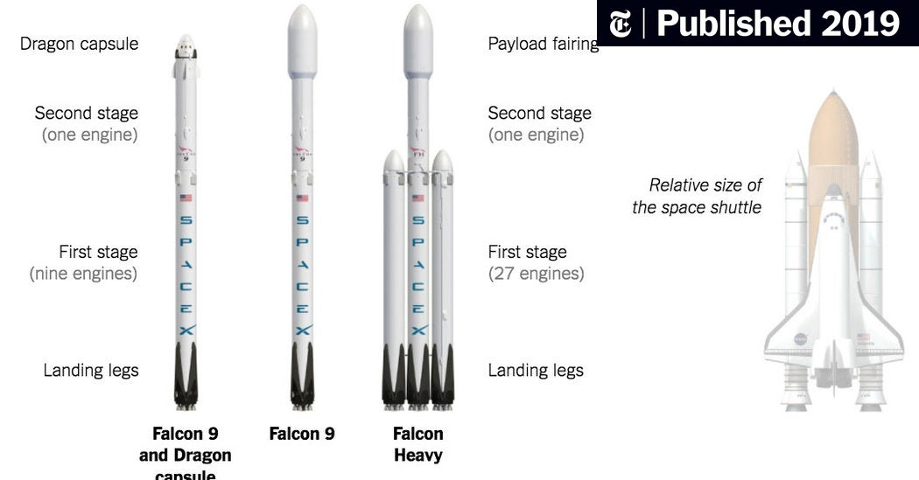
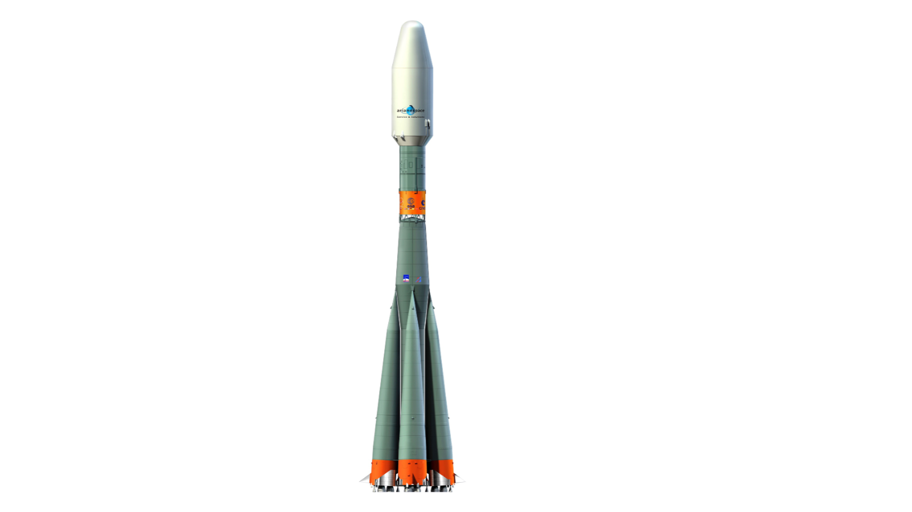
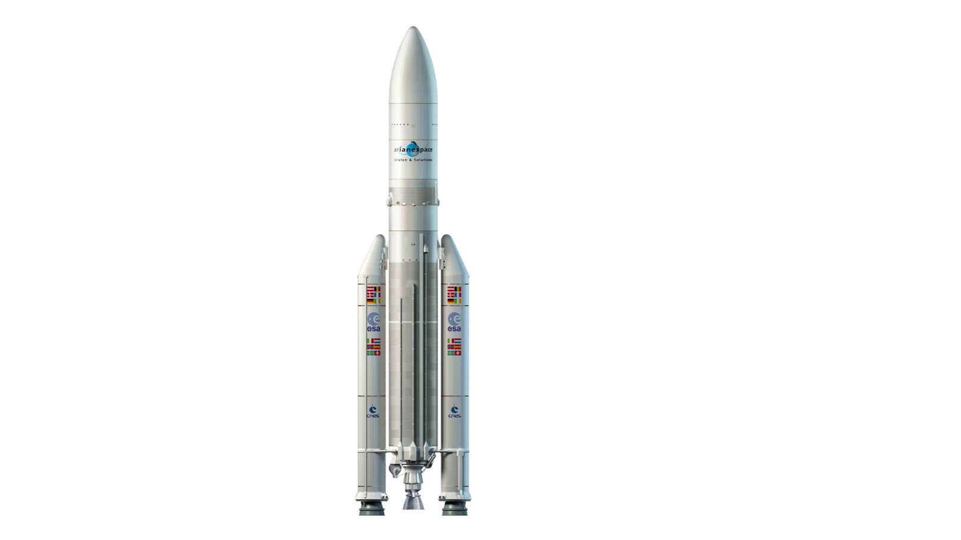

Slide 3
Adoption Rate (%)
Market Share (%)
Admin Area (km²)
Population Data
Minimum Elevation Angle
Path Loss
Orbital Altitude
Link Budget
Active Users (%)
Population Density (Pop/km2)
Channel Capacity
Satellite Capacity
Number of Satellites
Active User Density (Users/km²)
Total Usable Constellation Capacity
Demand Model
Capacity Model
LEO Sustainability Analytics
Demand
Capacity
Emissions
Costs
Emissions Model
Cost Model
Total Constellation Emissions
Assessment Period
(Years)
Total Cost of Ownership (TCO) ($US)
Discount
Rate (%)
Launch Event
Capital Expenditure
Operational Expenditure
Lifecycle Management of Propellant
Launch Campaign
Launcher Assembly and Testing
Manu-facture
Customer Acquisition
Mainten-ance
R&D
Rocket Launches
Regulatory
Staff
Infra-structure
Production of Propellant
Launcher Production & Development
Transportation of Launcher
Ground Stations
Spectrum
Energy

